Slide 1


International Economics: Theory and Policy
Twelfth Edition
Chapter 9
The Instruments of Trade Policy
Copyright © 2022, 2018, 2015 Pearson Education, Inc. All Rights Reserved
Notes:
If this PowerPoint presentation contains mathematical equations, you may need to check that your computer has the following installed:
1) MathType Plugin
2) Math Player (free versions available)
3) NVDA Reader (free versions available)

Slide 2
Learning Objectives
9.1 Evaluate the costs and benefits of tariffs, their welfare effects, and winners and losers of tariff policies.
9.2 Discuss what export subsidies and agricultural subsidies are, and explain how they affect trade in agriculture in the United States and the European Union.
9.3 Recognize the effect of voluntary export restraints (V E Rs) on both importing and exporting countries, and describe how the welfare effects of these V E Rs compare with tariff and quota policies.

Slide 3
Preview
Partial equilibrium analysis of tariffs in a single industry: supply, demand, and trade
Costs and benefits of tariffs
Export subsidies
Import quotas
Voluntary export restraints
Local content requirements

Slide 4
Types of Tariffs
A tariff is a tax levied when a good is imported.
A specific tariff is levied as a fixed charge for each unit of imported goods.
For example, $3 per barrel of oil.
An ad valorem tariff is levied as a fraction of the value of imported goods.
For example, 25% tariff on the value of imported trucks.

Slide 5
Supply, Demand, and Trade in a Single Industry (1 of 4)
Consider how a tariff affects a single market, say that of wheat.
Suppose that in the absence of trade the price of wheat is higher in Home than it is in Foreign.
With trade, wheat will be shipped from Foreign to Home until the price difference is eliminated.

Slide 6
Supply, Demand, and Trade in a Single Industry (2 of 4)
An import demand curve is the difference between the quantity that Home consumers demand minus the quantity that Home producers supply, at each price.
The Home import demand curve
intercepts the price axis at
and is downward sloping:
As price increases, the quantity of imports demanded declines.

Slide 7
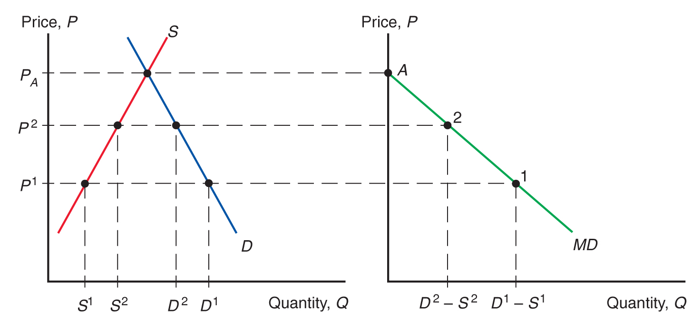
Figure 9.1 Deriving Home’s Import Demand Curve
As the price of the good increases, Home consumers demand less, while Home producers supply more, so that the demand for imports declines.
Notes:
Graph 1 has D as a steeply falling line and S as a steeply rising line. D and S intersect at y = P sub A. The S curve rises through (S super 1, P super 1) and (S super 2, P super 2). The D curve falls through (D super 2, P super 2) and (D super 1, P super 1). On the second graph, these points generate the import demand curve, M D, which is a falling line. Curve M D falls through point A at y = P sub A, at the y intercept, through point 2, (D super 2 minus S super 2, P super 2), and through point 1, (D super 1 minus S super 1, P super 1). All values are estimated.

Slide 8
Supply, Demand, and Trade in a Single Industry (3 of 4)
An export supply curve is the difference between the quantity that Foreign producers supply minus the quantity that Foreign consumers demand, at each price.
The Foreign export supply curve
intersects the price axis at
and is upward sloping:
As price increases, the quantity of exports supplied rises.

Slide 9
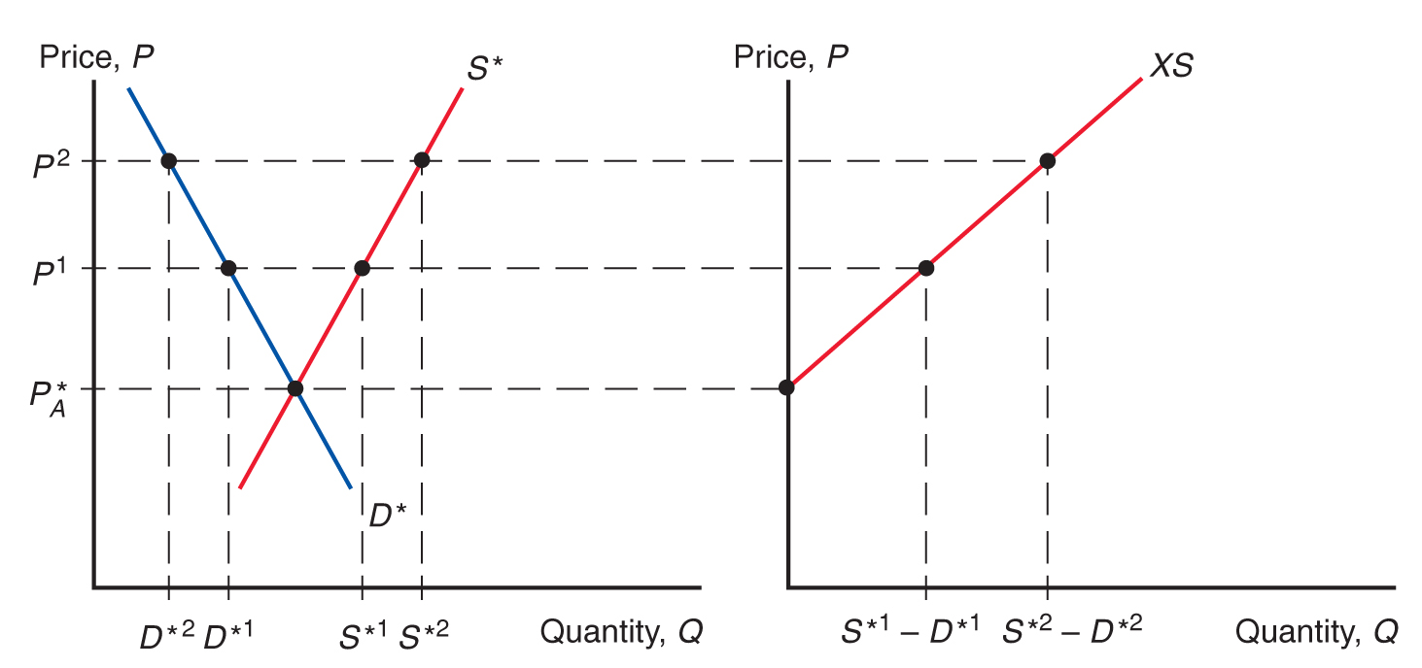
Figure 9.2 Deriving Foreign’s Export Supply Curve
As the price of the good rises, Foreign producers supply more while Foreign consumers demand less, so that the supply available for export rises.
Notes:
Graph 1 has curves, D asterisk as a steeply falling line and S asterisk as a steeply rising line. The lines intersect at y = P asterisk sub A. The curve S asterisk rises through (S asterisk super 1, P super 1) and (S asterisk super 2, P super 2). The curve D asterisk falls through (D asterisk super 2, P super 2) and (D asterisk super 1, P super 1). The second graph plots the export supply curve, X S, which is a rising line. Curve X S rises from y = P asterisk sub A, at the y intercept, through (S asterisk super 1 minus D asterisk super 1, P super 1), and through (S asterisk super 2 minus D asterisk super 2, P super 2).

Slide 10
Supply, Demand, and Trade in a Single Industry (4 of 4)
In equilibrium,
import demand = export supply,
home demand + foreign demand = home supply + foreign supply,
world demand = world supply.

Slide 11
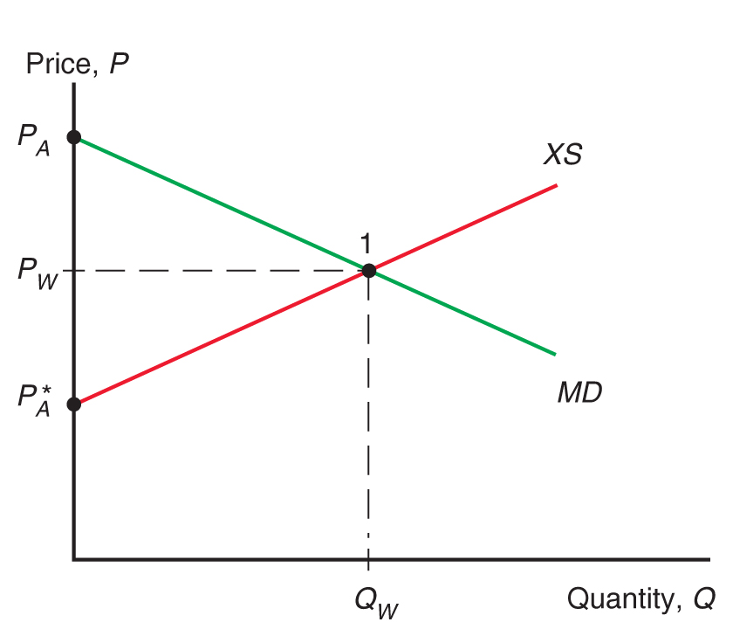
Figure 9.3 World Equilibrium
The equilibrium world price is where Home import demand (M D curve) equals Foreign export supply (X S curve).
Notes:
The curves intersect at point 1, (Q sub W, P sub W). Y = P sub W is roughly midway between P sub A and P sub A asterisk.

Slide 12
Effects of a Tariff (1 of 4)
A tariff acts like a transportation cost, making sellers unwilling to ship goods unless the Home price exceeds the Foreign price by the amount of the tariff:
A tariff makes the price rise in the Home market and fall in the Foreign market.

Slide 13
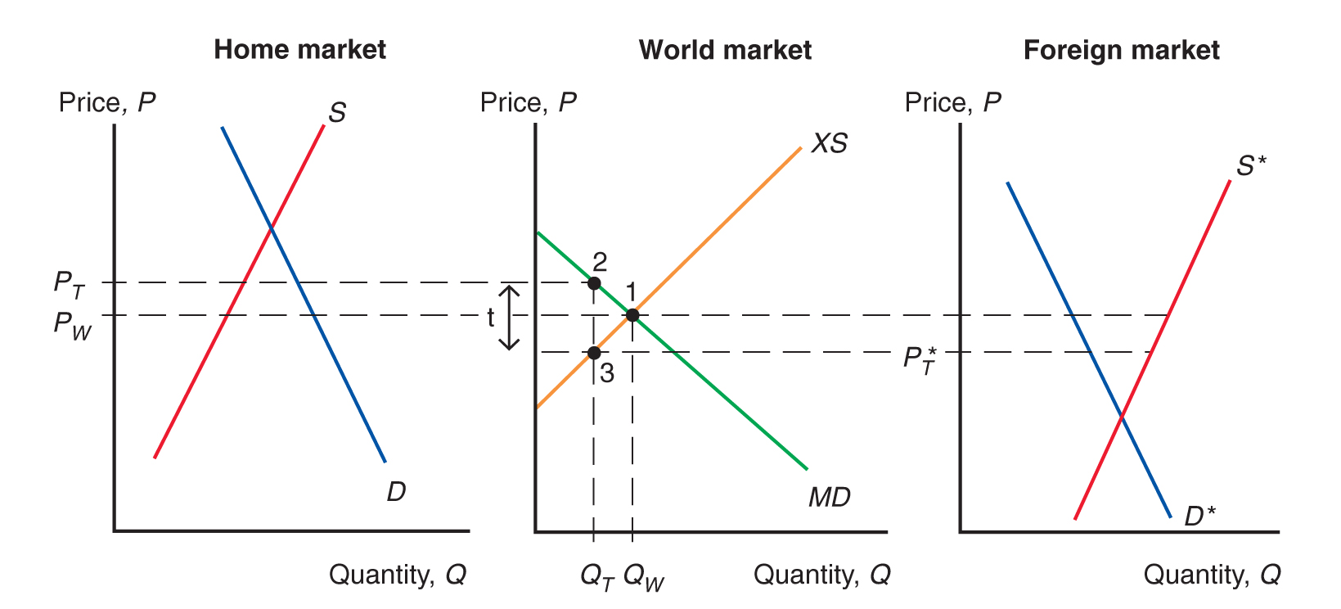
Figure 9.4 Effects of a Tariff
A tariff raises the price in Home while lowering the price in Foreign. The volume traded thus declines.
Notes:
Dashed lines extend from y = P sub W and, higher, y = P sub T, both of which are below the point of intersection. These lines extend through graph 2. Graph 2 is the world market with a falling M D curve and a rising X S curve that intersect at point 1, (Q sub W, P sub W). Point 2 is on M D, above point 1, at (Q sub T, P sub T). Point 3 is on X S and below point 1, at x = Q sub T. The vertical distance between points 3 and 2 = t. Graph 3 is the foreign market with falling D asterisk and rising S asterisk. Y = P asterisk sub T, which extends from point 3 on graph 2, is above the intersection.

Slide 14
Effects of a Tariff (3 of 4)
Because the price in the Foreign market falls from
under free trade to
with the tariff,
Home producers supply more and Home consumers demand less, so
the quantity of imports falls from
under free trade
to
with the tariff.

Slide 15
Effects of a Tariff (2 of 4)
Because the price in the Home market rises from
under free trade to
with the tariff,
Foreign producers supply less, and Foreign consumers demand more, so
the quantity of exports falls from
to

Slide 16
Effects of a Tariff (4 of 4)
The quantity of Home imports demanded equals the quantity of Foreign exports supplied when
The increase in the price in Home can be less than the amount of the tariff.
Part of the effect of the tariff causes the Foreign export price to decline.
But this effect is sometimes very small.

Slide 17
Effects of a Tariff in a Small Country
When a country is “small,” it has no effect on the foreign (world) price because its demand is an insignificant part of world demand for the good.
The foreign price does not fall, but remains at
The price in the home market rises by the full amount
of the tariff, to

Slide 18
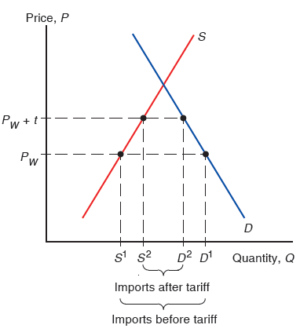
Figure 9.5 A Tariff in a Small Country
When a country is small, a tariff it imposes cannot lower the foreign price of the good it
imports. As a result, the price of the import rises from
and the quantity of
imports demanded falls from
Notes:
A rising S curve intersects a falling D curve. S rises through (S super 1, P sub W) and (S super 2, P sub W + t). D falls through (D super 2, P sub W + t), and (D super 1, P sub W). The horizontal distance between S super 1 and D super 1 is imports before the tariff. The horizontal distance between S super 2 and D super 2 is imports after tariff.

Slide 19
Measuring the Amount of Protection (1 of 3)
The effective rate of protection measures how much protection a tariff (or other trade policy) provides.
It represents the change in value that firms in an industry add to the production process when trade policy changes, which depends on the change in prices the trade policy causes.
Effective rates of protection often differ from tariff rates because tariffs affect sectors other than the protected sector, causing indirect effects on the prices and value added for the protected sector.

Slide 20
Measuring the Amount of Protection (2 of 3)
For example, suppose that automobiles sell in world markets for $8,000, and they are made from factors of production worth $6,000.
The value added of the production process is
Suppose that a country puts a 25% tariff on imported autos so that home auto assembly firms can now charge up to $10,000 instead of $8,000.

Slide 21
Measuring the Amount of Protection (3 of 3)
The effective rate of protection for home auto assembly firms is the change in value added:
In this case, the effective rate of protection is greater than the tariff rate.

Slide 22
Costs and Benefits of Tariffs
A tariff raises the price of a good in the importing country, so it hurts consumers and benefits producers there.
In addition, the government gains tariff revenue.
How to measure these costs and benefits?
Use the concepts of consumer surplus and producer surplus.

Slide 23
Consumer and Producer Surplus (1 of 2)
Consumer surplus measures the amount that consumers gain from purchases by computing the difference in the price actually paid from the maximum price they would be willing to pay for each unit consumed.
When price increases, the quantity demanded decreases as well as the consumer surplus.

Slide 24
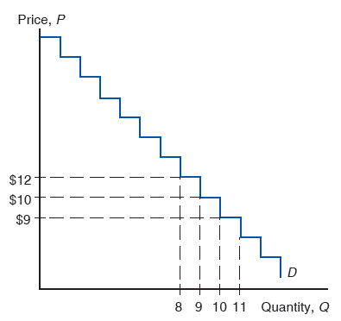
Figure 9.6 Deriving Consumer Surplus from the Demand Curve
Consumer surplus on each unit sold is the difference between the actual price and what consumers would have been willing to pay.

Slide 25
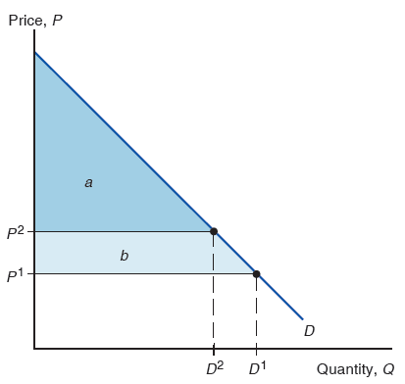
Figure 9.7 Geometry of Consumer Surplus
Consumer surplus is equal to the area under the demand curve and above the price.
Notes:
The right triangle area above the horizontal line at y = P super 2, bounded by the y-axis and D curve, is shaded and labeled, ay. The area below this triangle and above y = P super 1, also bounded by the y-axis and the D curve, is shaded and labeled, b.

Slide 26
Consumer and Producer Surplus (2 of 2)
Producer surplus measures the amount that producers gain from sales by computing the difference in the price received from the minimum price at which they would be willing to sell.
When price increases, the quantity supplied increases as well as the producer surplus.

Slide 27
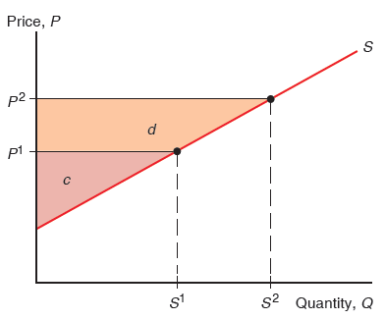
Figure 9.8 Geometry of Producer Surplus
Producer surplus is equal to the area above the supply curve and below the price.
Notes:
The right triangle area below the horizontal line at y = P super 1, bounded by the y-axis and S curve, is shaded and labeled c. The area above this triangle and below y = P super 2, also bounded by the y-axis and the S curve, is shaded and labeled d.

Slide 28
Measuring the Costs and Benefits of Tariffs (1 of 4)
A tariff raises the price in the importing country:
consumer surplus decreases (consumers worse off)
producer surplus increases (producers better off).
the government collects tariff revenue equal to the tariff rate times the quantity of imports with the tariff.
Change in welfare due to the tariff is

Slide 29
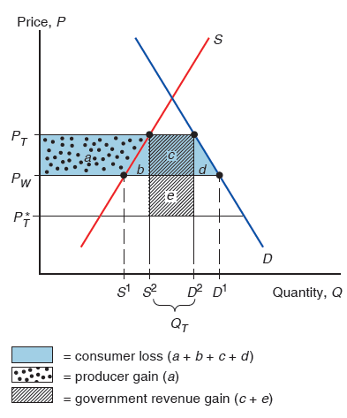
Figure 9.9 Costs and Benefits of a Tariff for the Importing Country
The costs and benefits to different groups can be represented as sums of the five areas a, b, c, d, and e.
Notes:
S rises through a line at y = P sub T asterisk, then (S super 1, P sub W), and then (S super 2, P sub T). D falls through (D super 2, P sub T) and then (D super 1, P sub W), and a line at y = P sub T asterisk. On the x-axis, the distance between S super 2 and D super 2 is Q sub T. Four areas on the graph are shaded. The area between the y-axis, the D curve, y = P sub W, and P sub T is shaded, and represents consumer loss, ay + b + c + d. Area ay is in this shaded area to the left of the S curve, and represents producer gain. Area c is a square between (S super 2, P super T), (D super 2, P super T) and y = P sub W. Areas b and d are triangular shapes between the S and D curves, on either side of square, c, bounded below by y = P sub W. Area e is an identical square below c, between y = P sub W and y = P sub T asterisk. Areas c + e represent government revenue gain.

Slide 30
Measuring the Costs and Benefits of Tariffs (2 of 4)
For a “large” country, whose imports and exports affect world prices, the welfare effect of a tariff is ambiguous.
The triangles b and d represent the efficiency loss.
The tariff distorts production and consumption decisions: producers produce too much and consumers consume too little.
The rectangle e represents the terms of trade gain.
The tariff lowers the Foreign price, allowing Home to buy its imports cheaper.

Slide 31
Measuring the Costs and Benefits of Tariffs (3 of 4)
Part of government revenue (rectangle e) represents the terms of trade gain, and part (rectangle c) represents some of the loss in consumer surplus.
The government gains at the expense of consumers and foreigners.
If the terms of trade gain exceed the efficiency loss, then national welfare will increase under a tariff, at the expense of foreign countries.
However, foreign countries are apt to retaliate.

Slide 32
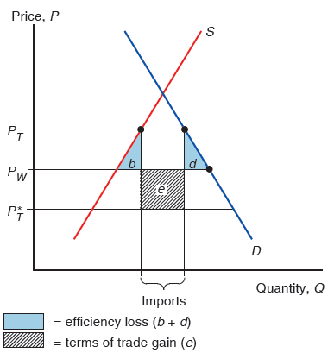
Figure 9.10 Net Welfare Effects of a Tariff
The colored triangles represent efficiency losses, while the rectangle represents a terms of trade gain.
Notes:
The triangular shaded areas, b and d, between the curves and between y = P sub W and y = P sub T, represent efficiency loss, b + d. The shaded square below the triangles and at the center, between y = P sub T asterisk below and y = P sub W above, represents the terms of trade gain. On the x-axis, the central area that contains square e, with triangles b and d on either side, represents imports.

Slide 33
Measuring the Costs and Benefits of Tariffs (4 of 4)
Tariffs can lead trading partners to retaliate with their own tariffs, thus hurting exporters in the country that first adopted the tariff.
Tariffs can be hard to remove and large tariffs may induce producers to engage in wasteful activities to avoid paying tariffs.
Ford and Subaru install (then later remove) seats in vans and pickups trucks to avoid U.S. tariff on imports of light commercial trucks.

Slide 34
Winners and Losers of the Trump Trade War (1 of 3)
Looking at the timeline of average tariffs imposed by the Trump administration 2018–2019:
Some tariffs on specific goods (solar panels, washing machines, steel, and aluminum) were imposed on a large set of exporting countries.
Some tariffs were targeted at specific countries (mostly China but also the European Union later on) and covered many different goods.
By 2019, over 66% of Chinese exports to the United States were hit by the tariffs shown in Figure 9-11.

Slide 35
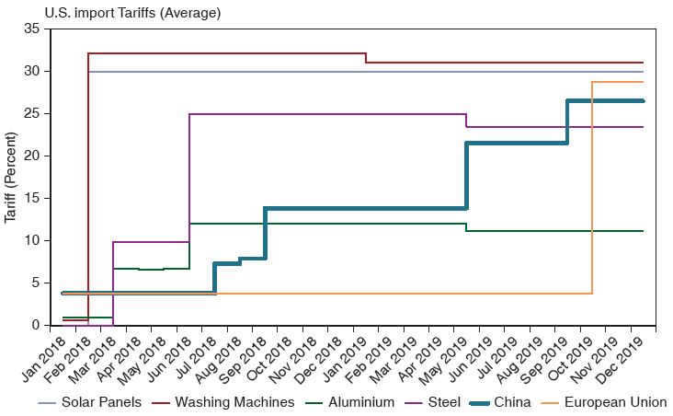
Figure 9.11 Average Tariffs on U.S. Imports
Over the 2018–2019 period, the Trump administration drastically increased tariffs targeted both at specific goods as well as specific trading partners.
Source: 2019 update of Pablo D. Fajgelbaum, Pinelopi K. Goldberg, Patrick J. Kennedy, and Amit K. Khandelwal, “The Return to Protectionism,” The Quarterly Journal of Economics 135, no. 1 (February 1, 2020), p p. 1–55.
Notes:
The graph plots tariff in percent versus years from January 20 18 to December 20 19. The timeline for Washing Machines is as follows. (January 20 18, 0), (February 20 18 to December 20 18, 33), and (December 20 18 to December 20 19, 32). The timeline for Solar Panels is as follows. (January 20 18, 0) and (February 20 18 to December 20 19, 30). The timeline for Aluminum is as follows. (January 20 18 to February 20 18, 2), (March 20 18 to May 20 18, 6.5), (June 20 18 to April 20 19, 13), and (May 20 19 to December 20 19, 12). The timeline for Steel is as follows. (January 20 18 to February 20 18, 0.2), (March 20 18 to May 20 18, 10), (June 20 18 to April 20 19, 25), and (May 20 19 to December 20 19, 24). The timeline for China is as follows. (January 20 18 to June 20 18, 4), (July 20 18, 7), (August 20 18, 7.5), (September 20 18 to April 20 19, 14), (May 20 19 to August 20 19, 23), and (September 20 19 to December 20 19, 27). The timeline for the European Union is as follows. (January 20 18 to October 20 19, 4) and (November 20 19 to December 20 19, 29). All values are estimated.

Slide 36
Winners and Losers of the Trump Trade War (2 of 3)
How have those tariff increases affected the prices of goods consumed in the United States?
Any terms-of-trade gains were negligible—foreign exporters did not lower their prices to absorb hardly any of the tariffs.
Almost the entire brunt of the tariffs has been borne by U.S. consumers and firms buying intermediate goods.
The higher import prices due to the tariffs represented a substantial annual cost increase of $300-900 for U.S. households.

Slide 37
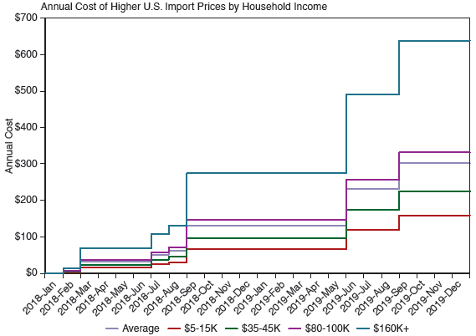
Figure 9.12 Annual Cost of Higher Prices by Household Income
The higher prices for imported goods due to the new tariffs represented a substantial annual cost increase for U.S. households.
Source: Kirill Borusyak and Xavier Jaravel, “The Distributional Effects of Trade: Theory and Evidence from the United States,” S S R N Scholarly Paper, October 6, 2018.
Notes:
The graph plots annual cost versus years from January 20 18 to December 20 19. The timeline for average is as follows. (January 20 18, $0), (February 20 18 to June 20 18, $40), (July 20 18 to August 20 18, $50), (August 20 18 to May 20 19, $130), (May 20 19 to August 20 19, $240), and (August 20 19 to December 20 19, $300). The timeline for $5 to $15 K is as follows. (January 20 18 to February 20 18, $0), (February 20 18 to June 20 18, $20), (June 20 18 to July 20 18, $25), (July 20 18 to August 20 18, $30), (August 20 18 to May 20 19, $60), (May 20 19 to August 20 19, $120), and (August 20 19 to December 20 19, $160). The timeline for $35 to 45 K is as follows. (January 20 18 to February 20 18, $5), (February 20 18 to June 20 18, $20), (June 20 18 to July 20 18, $40), (July 20 18 to August 20 18, $50, (August 20 18 to May 20 19, $100), (May 20 19 to August 20 19, $170), and (August 20 19 to December 20 19, $230). The timeline for $80 to 100 K is as follows. (January 20 18 to February 20 18, $0), (February 20 18 to June 20 18, $50), (June 20 18 to July 20 18, $65), (July 20 18 to August 20 18, $70), (August 20 18 to May 20 19, $150), (May 20 19 to August 20 19, $250), and (August 20 19 to December 20 19, $300). The timeline for $160 K plus is as follows. (January 20 18 to February 20 18, $10), (February 20 18 to June 20 18, $80), (June 20 18 to July 20 18, $110), (July 20 18 to August 20 18, $140), (August 20 18 to May 20 19, $280), (May 20 19 to August 20 19, $500), and (August 20 19 to December 20 19, $650). All values are estimated.

Slide 38
Winners and Losers of the Trump Trade War (3 of 3)
The new tariffs imposed by the United States inevitably led to retaliation by its trading partners. Looking at the progression of those retaliatory tariffs (averaged over the set of targeted goods) over time:
China responded with higher tariffs on par with the higher tariffs imposed by the United States.
Major steel and aluminum exporters to the United States responded with tariffs on various U.S. imports.
All those retaliatory tariffs overwhelmingly targeted agricultural products. The Chinese tariffs covered virtually all U.S. agricultural exports.

Slide 39
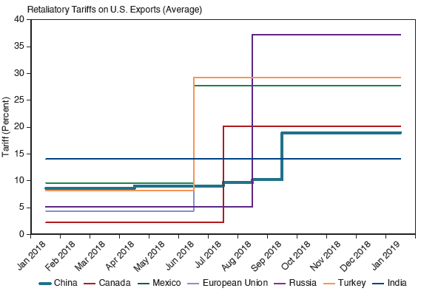
Figure 9.13 Average Retaliatory Tariffs on U.S. Exports
All of the United States’ major trading partners responded to the tariffs on their exports with tariffs of their own targeting U.S. exports.
Source: 2019 update of Pablo D. Fajgelbaum, Pinelopi K. Goldberg, Patrick J. Kennedy, and Amit K. Khandelwal, “The Return to Protectionism,” The Quarterly Journal of Economics 135, no. 1 (February 1, 2020), p p. 1–55.
Notes:
The graph plots Tariff in percent versus years from January 20 18 to January 20 19. The time line for China is as follows. (January 20 18 to March 20 18, 9%), (April 20 18 to June 20 18, 9.5%), (July 20 18, 10%), (August 20 18, 10.2), and (September 20 18 to January 20 19, 20). The timeline for Canada is as follows. (January 20 18 to June 20 18, 3%) and (July 20 18 to January 20 19, 22%). The timeline for Mexico is as follows. (January 20 18 to June 20 18, 10%) and (July 20 18 to January 20 19, 27%). The timeline for European Union is as follows. (January 20 18 to May 20 18, 4.5%) and (June 20 18 to January 20 19, 29.5%). The timeline for Turkey is as follows. (January 20 18 to May 20 18, 8%) and (June 20 18 to January 20 19, 30%). The timeline for India is as follows. (January 20 18 to January 20 19, 14%). All values are estimated.

Slide 40
Tariffs for the Long Haul
Tariffs can induce producers to behave in creative —though ultimately wasteful—ways in order to avoid them.
Ford wants to avoid paying 25% tariff on light commercial trucks when imports its small commercial van from Europe.
Ford installs rear windows, rear seats, and seat belts prior to shipping the vehicles to the United States in an attempt to be classified as passenger vehicles (and pay 2.5% tariff).
Upon arrival, process reversed before delivery to dealers.

Slide 41
Export Subsidy (1 of 3)
An export subsidy can also be specific or ad valorem:
A specific subsidy is a payment per unit exported.
An ad valorem subsidy is a payment as a proportion of the value exported.
An export subsidy raises the price in the exporting country, decreasing its consumer surplus (consumers worse off) and increasing its producer surplus (producers better off).

Slide 42
Export Subsidy (2 of 3)
Also, government revenue falls due to paying
for the export subsidy.
An export subsidy lowers the price paid in importing
countries
In contrast to a tariff, an export subsidy worsens the terms of trade by lowering the price of exports in world markets.

Slide 43
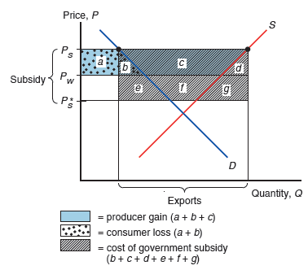
Figure 9.14 Effects of an Export Subsidy
An export subsidy raises prices in the exporting country while lowering them in the importing country.
Notes:
Horizontal lines are drawn from top to bottom at y = P sub S, y = P sub W, and y = P sub S asterisk. The vertical area between P sub S and P sub S asterisk represents subsidy. Points are plotted on the D and S curves at y = P sub S. The horizontal distance between these points represents exports. Between y = P sub S above and y = P sub W below, areas are shaded, labeled as follows: a square between the y-axis and the point on the D curve is labeled, ay; the triangular area between ay and the D curve is labeled, b; the space between the D and S curve is labeled, c; the triangular space to the right of the S curve, bounded by the point on the S curve at the right, is labeled, d. Consumer loss = ay + b. Producer gain = ay + b + c. Between P sub W above and P sub S asterisk below, areas are shaded and labeled as follows: a trapezoid area between the point on the D curve and the D curve is labeled, e; the area between the D and S curves is labeled, f; the area to the right of the S curve, bounded by the point on the S curve, is labeled, g. Cost of government subsidy = b + c + d + e + f + g.

Slide 44
Export Subsidy (3 of 3)
An export subsidy damages national welfare.
The triangles b and d represent the efficiency loss.
The export subsidy distorts production and consumption decisions: producers produce too much and consumers consume too little compared to the market outcome.
The area b + c + d + f + g represents the cost of the subsidy paid by the government.
The terms of trade decrease, because the price of exports falls.

Slide 45
The Unfriendly Skies: Settling the Longest Running Trade Dispute (1 of 2)
The W T O labels production subsidies to exporters that are shown to harm foreign producers as “actionable” and allows the impacted countries to impose countervailing duties (tariffs) against the subsidizing country.
In 2004, the United States filed a case with the W T O complaining that European-owned Airbus had received favorable loan agreements for the development of their new A380 and A350 jumbo jets.
The European Union immediately filed a counterclaim that Boeing received tax rebates and favorable contracting terms from the U.S. government.

Slide 46
The Unfriendly Skies: Settling the Longest Running Trade Dispute (2 of 2)
Both governments claimed that assistance received by airplane manufacturers were actionable export subsidies. The W T O eventually ruled in favor of both cases.
In 2019, the United States imposed tariffs on European wines and specialty food items. The European Union retaliated with tariffs on U.S. whiskey, nuts, and tobacco.
In 2021, the United States and the European Union finally agreed to end their 17-year trade dispute regarding the production subsidies received by Boeing and Airbus (the world’s two largest passenger airplane manufacturers).

Slide 47
Import Quota (1 of 2)
An import quota is a restriction on the quantity of a good that may be imported.
This restriction is usually enforced by issuing licenses or quota rights.
A binding import quota will push up the price of the import because the quantity demanded will exceed the quantity supplied by Home producers and from imports.

Slide 48
Import Quota (2 of 2)
When a quota instead of a tariff is used to restrict imports, the government receives no revenue.
Instead, the revenue from selling imports at high prices goes to quota license holders.
These extra revenues are called quota rents.

Slide 49
An Import Quota in Practice: U.S. Sugar (1 of 4)
Imports of sugar into the United States limited and quota rights passed out to foreign governments.
Price of sugar in the United States has remained well above world prices.
U.S. consumers are hurt by more than U.S. producers benefit; foreigners earn quota rents.
Overall effect on national welfare negative.

Slide 50
An Import Quota in Practice: U.S. Sugar (2 of 4)
Under N A F T A, Mexico’s sugar exports were slowly exempted from the quota restrictions and the U.S. sugar price premium decreased to its lowest level in over 25 years.
U.S. sugar producers complained, and the U.S. Commerce Department sharply reduced Mexican sugar imports.
Imposed a 64% anti-dumping tariff and then negotiated a suspension of the tariff in return for lower exports.

Slide 51
An Import Quota in Practice: U.S. Sugar (3 of 4)
With access to the world sugar market successfully impeded, U.S. sugar prices have substantially risen again.
In 2015, that price was almost double the world price.
For 2014, the sugar quota is estimated to:
cost consumers 3.5 billion ($11 per person or $30 for a typical household)
generate producer surplus losses for food producers who use refined sugar as an ingredient) of $909 million
for a total cost estimate of $4.4 billion
benefit sugar producers $3.9 billion (mostly to refiners)

Slide 52
An Import Quota in Practice: U.S. Sugar (4 of 4)
Eliminating the sugar quota, by reducing the price of sugar in the United States, would generate 17,000–20,000 new jobs in producing foods containing sugar.
Far more than the 500–2,000 jobs that might be lost in the sugar industry.
Would turn the United States from a net importer to a net exporter of sugar-containing foods.
The sugar producers are better lobbyists than the sugar-containing food sector so this protection has been extended.

Slide 53
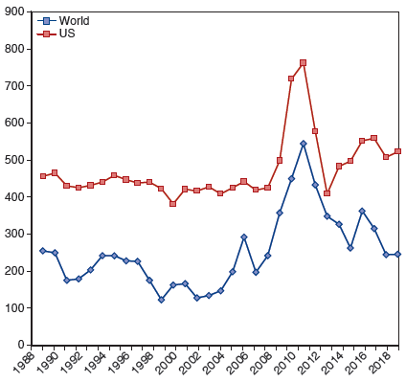
Figure 9.15 U.S. and World Raw Sugar Prices, 1989–2019
Source: U.S. Department of Agriculture.
Notes:
The double line graph of United States and world raw sugar prices plots dollars per ton versus year, 19 88 to 20 18. The plot for U S generally remains the same from (19 90, 475) through (2007, 450), and then rises to (20 12, 780), before falling to (20 14, 400) and then rising to (20 16, 490). The plot for world generally falls from (19 90, 475) to (2003, 120), then rises to (2007, 300), falls to (2008, 200), and rises again to (20 12, 550); the plot then falls to (20 16, 280). All values are estimated.

Slide 54
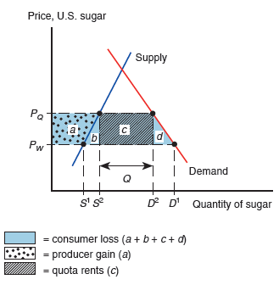
Figure 9.16 Effects of the U.S. Import Quota on Sugar
The quota level Q raises the price of sugar in the United States above the world price
The higher price associated with the quota induces an increase in U.S.
sugar production
and a reduction in U.S. sugar consumption
Notes:
The S curve rises through (S super 1, P sub W) and then (S super 2, P sub Q). The D curve falls through (D super 2, P sub Q) and then (D super 1, P sub W). The horizontal area between x = S super 2 and x = D super 2 represents Q. Between P sub Q above and P sub W below, areas are shaded and labeled as follows: between the y-axis and the S curve, is labeled ay; the triangular area below the S curve between x = S super 1 and x = S super 2 is labeled, b; the rectangular area between S super 2 and D super 2 is labeled, c; the triangular area below the D curve between D super 2 and D super 1 is labeled, d. Consumer loss = ay + b + c + d. Producer gain = ay. Quota rents = c.

Slide 55
Voluntary Export Restraint
A voluntary export restraint works like an import quota, except that the quota is imposed by the exporting country rather than the importing country.
These restraints are usually requested by the importing country.
The profits or rents from this policy are earned by foreign governments or foreign producers.
Foreigners sell a restricted quantity at an increased price.

Slide 56
A Voluntary Export Restraint in Practice (1 of 2)
In 1979, sharp oil price increases caused the U.S. market to shift abruptly toward smaller cars.
Japanese producers moved in to fill the increased demand faster than U.S. auto companies could come out with smaller, more fuel-efficient models.
As the Japanese market share soared and U.S. output fell, strong political forces in the United States demanded protection.
Rather than act unilaterally and risk creating a trade war, the U.S. government asked the Japanese government to limit its exports.

Slide 57
A Voluntary Export Restraint in Practice (2 of 2)
The Japanese, fearing unilateral U.S. protectionist measures if they did not do so, agreed to limit their sales.
The first agreement, in 1981, limited Japanese exports to the United States to 1.68 million automobiles.
A revision raised that total to 1.85 million in 1984.
In 1985, the agreement was allowed to lapse.
The price of Japanese cars in the United States rose, with the rent captured by Japanese firms.
The total costs to the United States are estimated to have been $3.2 billion in 1984.

Slide 58
Local Content Requirement (1 of 5)
A local content requirement (also called rules of origin) is a regulation that requires a specified fraction of a final good to be produced domestically.
It may be specified in value terms, by requiring that some minimum share of the value of a good represent home value added, or in physical units.

Slide 59
Local Content Requirement (2 of 5)
From the viewpoint of domestic producers of inputs, a local content requirement provides protection in the same way that an import quota would.
From the viewpoint of firms that must buy home inputs, however, the requirement does not place a strict limit on imports, but allows firms to import more if they also use more home parts.

Slide 60
Local Content Requirement (3 of 5)
Local content requirement provides neither government revenue (as a tariff would) nor quota rents.
Instead, the difference between the prices of home goods and imports is averaged into the price of the final good and is passed on to consumers.

Slide 61
Local Content Requirement (4 of 5)
In 2020, the United States-Mexico-Canada Agreement (U S M C A) increased the regional content requirements for vehicles from 62.5 (with N A F T A) to 75%.
Any car or truck exported within North America must contain at least 75% of its content produced within the region.
An additional requirement stipulates that 45% of the content must be made by workers earning at least $16 an hour, which effectively excludes most of auto parts made in Mexico, where most wages are below that level.
Intended to impose additional restrictions on vehicles assembled in Mexico for sale in the U.S. market.

Slide 62
Local Content Requirement (5 of 5)
Any public work project funded by the American Recovery and Re-Investment Act of 2009 (A R R A) must use U.S. iron, steel, and manufactured goods (unless foreign bid more than 25% lower).
The Bay Bridge linking San Francisco and Oakland did not use A R R A funding because some key components would have been 23% ($400 million) more expensive.
Delays due to having to show that some items are unavailable from U.S. sources.
Has triggered protectionist clauses that shut U.S. firms out of opportunities abroad.

Slide 63
Other Trade Policies
Export credit subsidies
A subsidized loan to exporters
U.S. Export-Import Bank subsidizes loans to U.S. exporters.
Government procurement
Government agencies are obligated to purchase from home suppliers, even when they charge higher prices (or have inferior quality) compared to foreign suppliers.
Bureaucratic regulations (red tape)
Safety, health, quality, or customs regulations can act as a form of protection and trade restriction.

Slide 64
The Effects of Trade Policy: A Summary
For each trade policy, the price rises in the Home country adopting the policy.
Home producers supply more and gain.
Home consumers demand less and lose.
The world price falls when Home is a “large” country that affects world prices.
Tariffs generate government revenue; export subsidies drain it; import quotas do not affect government revenue.
All these trade policies create production and consumption distortions.

Slide 65
Table 9.1 Effects of Alternative Trade Policies
Policy | Tariff | Export Subsidy | Import Quota | Voluntary Export Restraint
Producer surplus | Increases | Increases | Increases | Increases
Consumer surplus | Falls | Falls | Falls | Falls
Government revenue | Increases | Falls (government spending rises) | No change (rents to license holders) | No change (rents to foreigners)
Overall national welfare | Ambiguous (falls for small country) | Falls | Ambiguous (falls for small country) | Falls

Slide 66
Summary (1 of 2)
A tariff increases the home price and the quantity supplied and reduces the quantity demanded and the quantity traded; also decreases the world price when the country is “large.”
A quota does the same; an export subsidy does the same.
Tariffs generate government revenue; export subsidies drain it; import quotas are revenue neutral.

Slide 67
Summary (2 of 2)
The welfare effect of a tariff, quota, or export subsidy can be measured by
efficiency loss from consumption and production distortions.
terms of trade gain or loss.
With import quotas, voluntary export restraints, and local content requirements, the government of the importing country receives no revenue.
With voluntary export restraints and occasionally import quotas, quota rents go to foreigners.

Slide 68
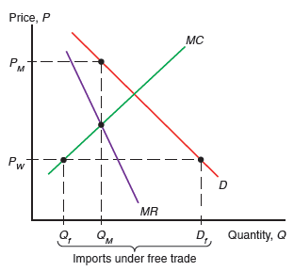
Figure 9A.1 A Monopolist under Free Trade
The threat of import competition forces the monopolist to behave like a perfectly competitive industry.
Notes:
The D curve falls steeply through (Q sub M, P sub M) and (D sub f, P sub W). The curve M R is to the left of the D curve and falls more steeply, through a lower point at x = Q sub M. The rising curve M C passes through (Q sub f, P sub W) and then intersects both M R and D. X = Q sub f, x = Q sub M, and x = D sub f together represent imports under free trade.

Slide 69
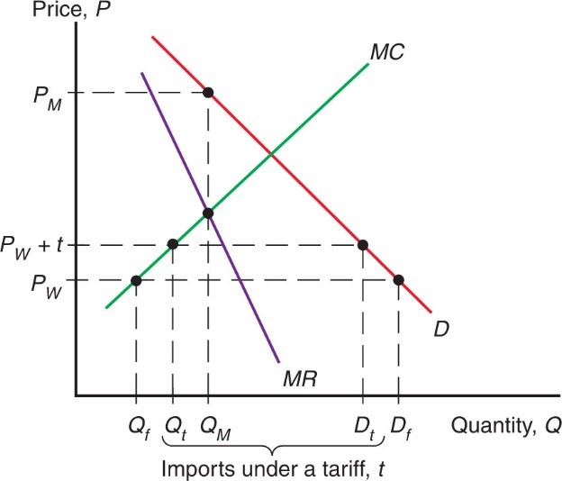
Figure 9A.2 A Monopolist Protected by a Tariff
The tariff allows the monopolist to raise its price, but the price is still limited by the threat of imports.
Notes:
A D curve falls through (Q sub M, P sub M), then (D sub t, P sub W + t), then (D sub f, P sub W). An M R curve, to the left of and falling more steeply than the D curve, falls through a lower point at x = Q sub M. The M C curve rises through (Q sub f, P sub W), (Q sub t, P sub W + t), and then intersects M R at x = Q sub M, and intersects D at an unlabeled point. X = Q sub f, x = Q sub M, and x = D sub t together represent imports under a tariff.

Slide 70
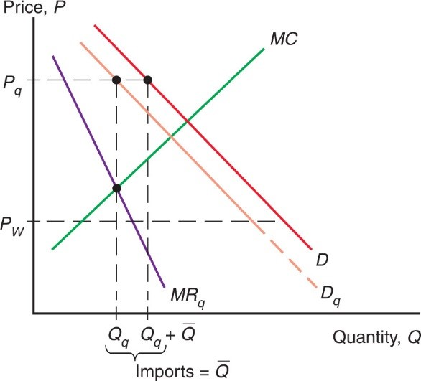
Figure 9A.3 A Monopolist Protected by an Import Quota
The monopolist is now free to raise prices, knowing that the domestic price of imports will rise too.
Notes:
A D curve falls through (Q sub q + Q bar, P sub q). The D curve shifts to the left and down to form D sub q, which passes through a point to the left of the first, at (Q sub q, P sub q). The M R sub q curve is to the left of and falls more steeply than D sub q, and intersects the rising M C curve at x = Q sub q, between y = P sub q above and P sub W below, closer to P sub W. X = Q sub q and x = Q sub q + Q bar represent imports = Q bar.

Slide 71
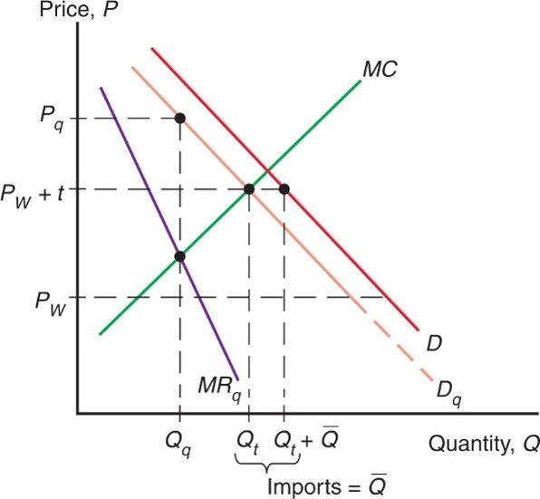
Figure 9A.4 Comparing a Tariff and a Quota
A quota leads to lower domestic output and a higher price than a tariff that yields the same level of imports.
Notes:
A D curve falls through (Q sub t + Q bar, P sub W + t). The D curve shifts to the left and down to form D sub q, which passes through (Q sub q, P sub q) and then (Q sub t, P sub W + t). The M R sub q curve is to the left of and falls more steeply than D sub q, and intersects the rising M C curve at x = Q sub q, to the left of x = Q sub t, and between y = P sub W + t above and P sub W below, closer to P sub W. X = Q sub t and x = Q sub t + Q bar represent imports = Q bar.

Slide 72

Copyright
This work is protected by United States copyright laws and is provided solely for the use of instructors in teaching their courses and assessing student learning. Dissemination or sale of any part of this work (including on the World Wide Web) will destroy the integrity of the work and is not permitted. The work and materials from it should never be made available to students except by instructors using the accompanying text in their classes. All recipients of this work are expected to abide by these restrictions and to honor the intended pedagogical purposes and the needs of other instructors who rely on these materials.

